Slide 1
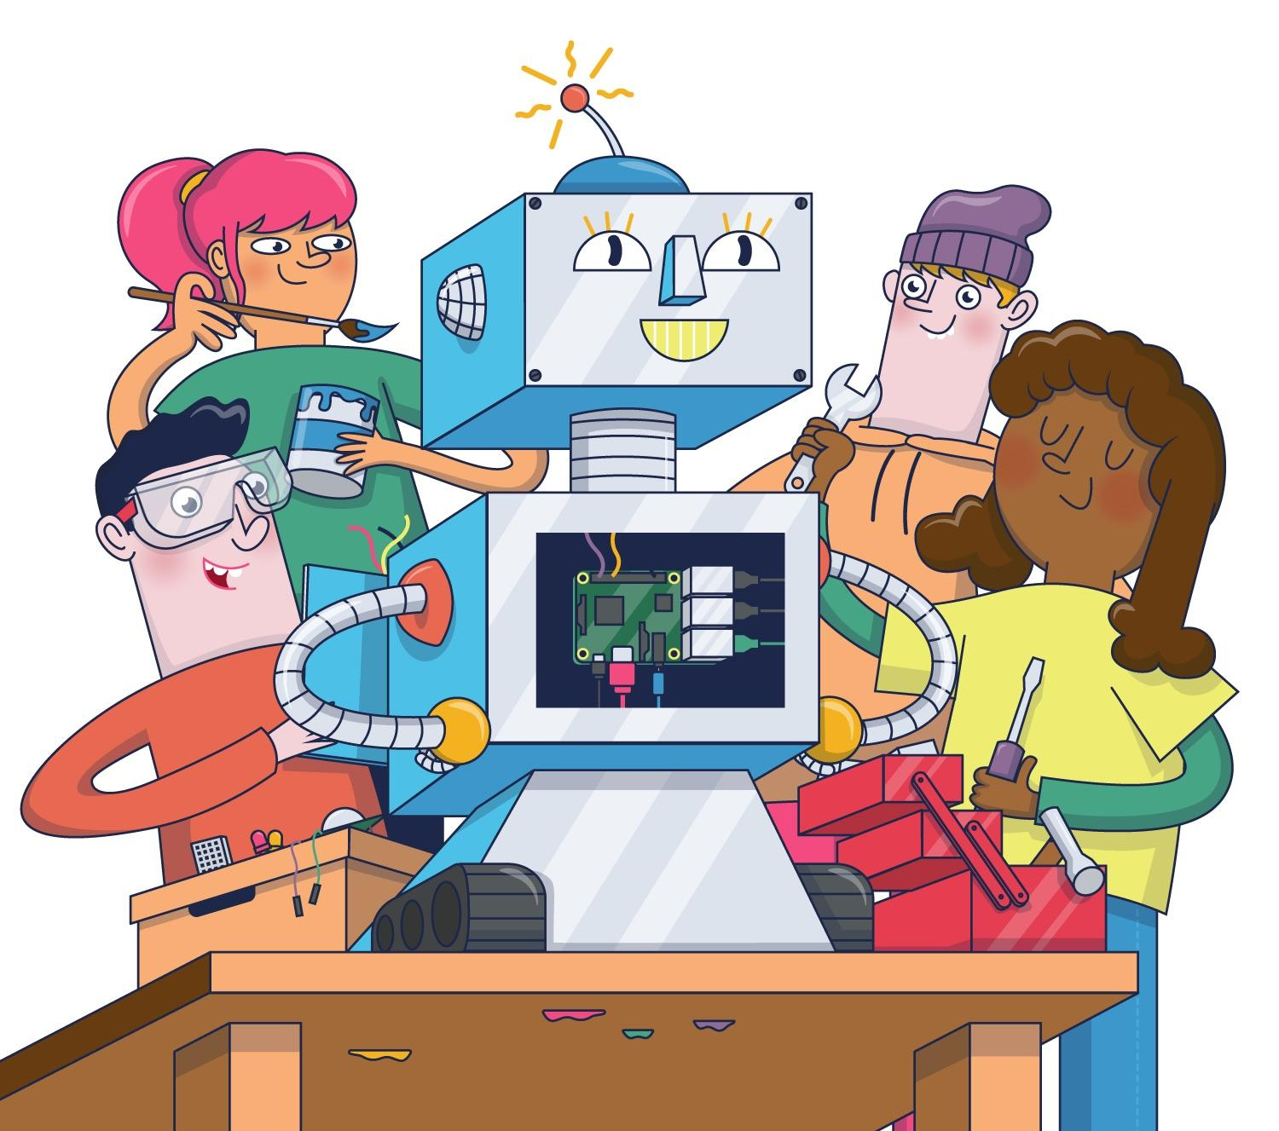
Getting Started with Raspberry Pi and Robotics Basics
An introduction to Embedded Systems, IoT and ROS2
Mohammed Farshad P.P
ROS2 Developer

Slide 2
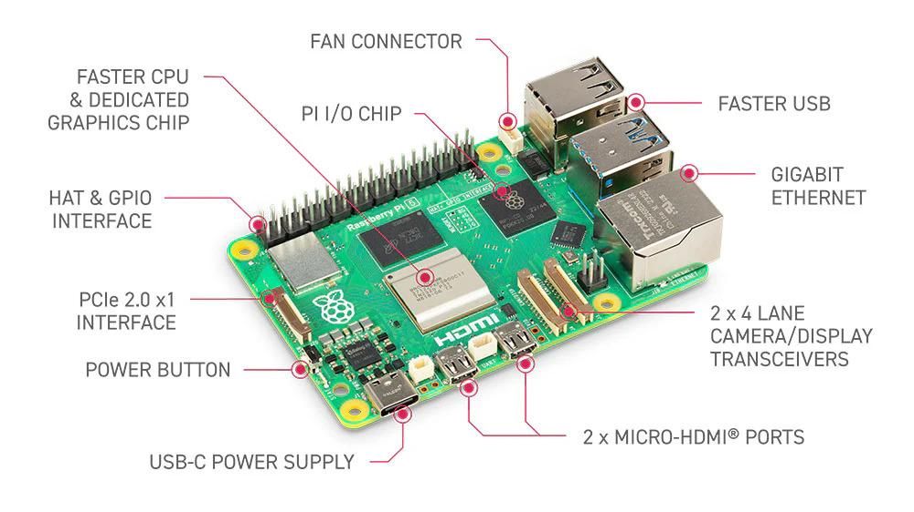
What is Raspberry Pi
A small, affordable single-board computer (SBC) developed by the Raspberry Pi Foundation
GPIO pins for connecting sensors, motors and electronics
Supports programming and robotics projects

Slide 3
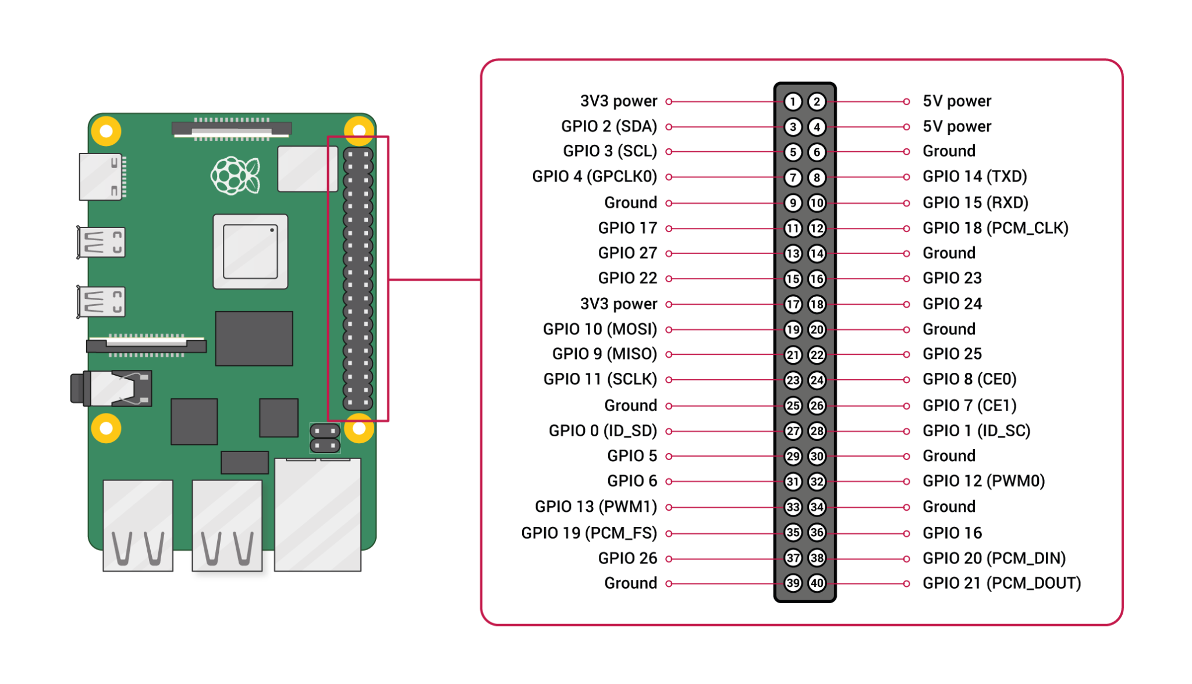
GPIO Pinout Overview
Pi pins uses 3.3v
Supports I2C, SPI, UART, PWM, and standard digital I/O
GPIO are controlled via python libraries (RPi.GPIO, gpiozero) or other languages

Slide 4

Raspberry Pi OS
Official Linux-based OS optimized for Raspberry Pi (formerly Raspbian)
Comes with pre-installed software for programming, robotics, and education
Supports both desktop GUI and headless operation via SSH

Slide 5
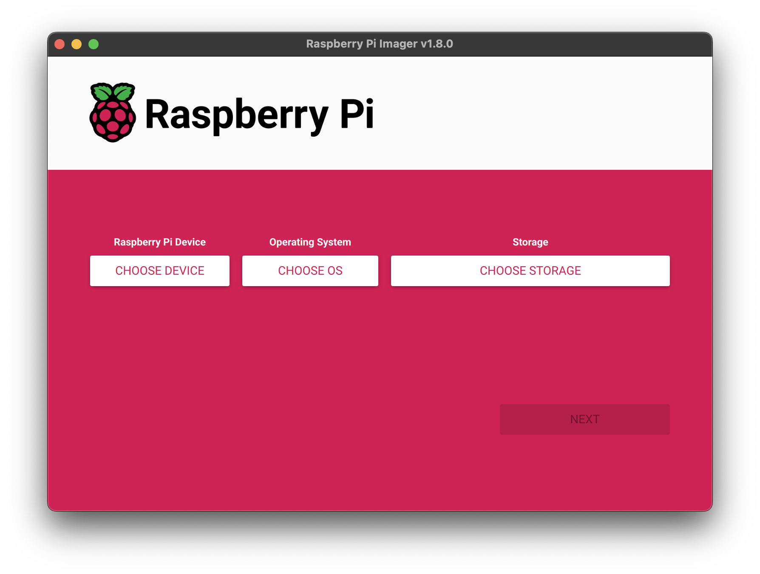
How to Boot The Raspberry Pi OS
Download Raspberry Pi OS
Flash OS to microSD Card
Insert microSD & Power On
Pi Boots Up

Slide 6
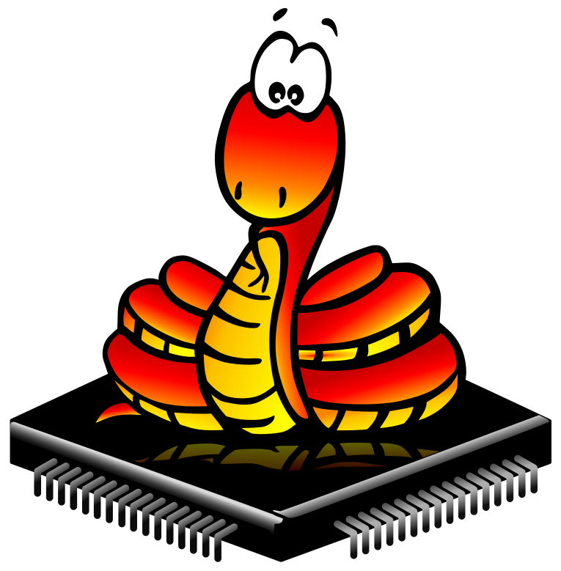
Python Basics
Easy to learn and widely used for various projects
Works seamlessly with RPi.GPIO and gpiozero libraries
Ideal for robotics, IoT, and automation projects

Slide 7
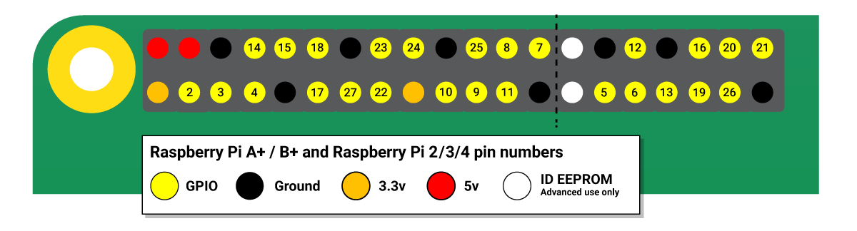
LED Blink & Sensor Testing
Learn to turn LEDs on/off using Raspberry Pi GPIO pins.
Measure temperature or humidity from a sensor
Combine coding in Python with hardware control to see real-time results.

Slide 8
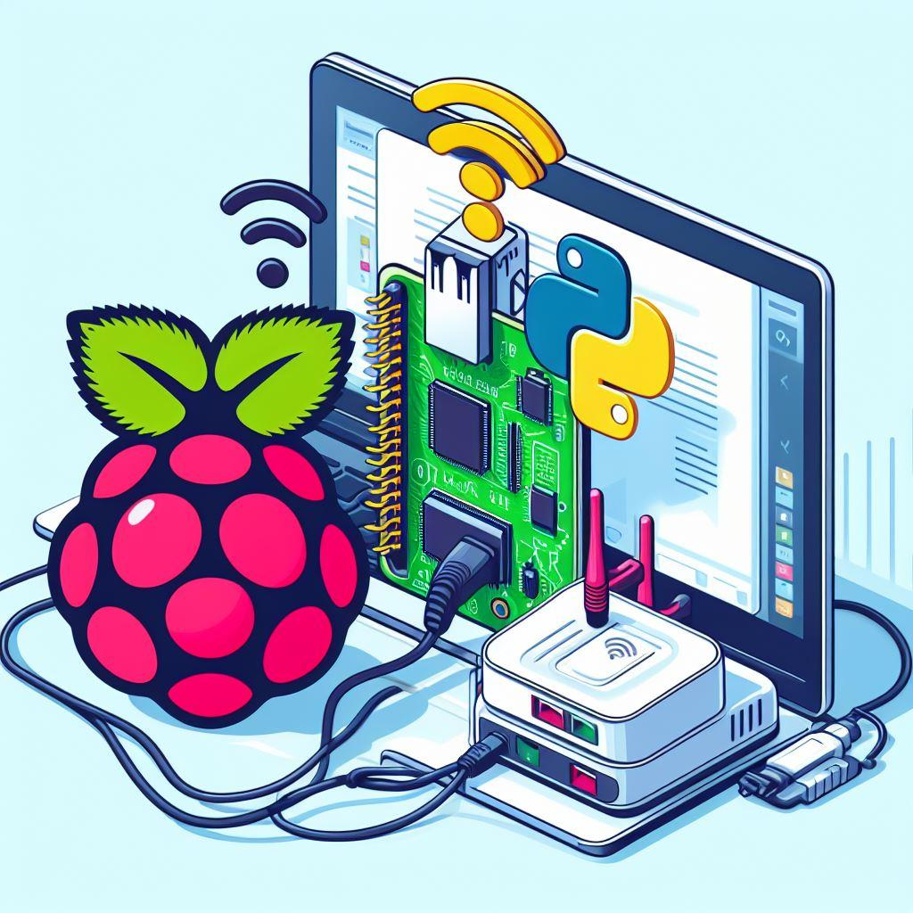
LED & Sensor Controlling Via Web Page
Control Raspberry Pi GPIO using a web page
Turn LEDs ON/OFF from browser without touching hardware
Use Python Flask to handle GPIO commands from the web page

Slide 9
ROS - Robot Operating System
A flexible framework for writing robot software, providing tools, libraries, and conventions
Uses topics, services, and actions for modular hardware and software interaction
Enables robot control, sensor integration, and autonomous behavior in real-time projects

